Slide 1
PHP
Sandeep Kumar

Slide 2
Agenda
PHP Introduction
Environment setup
Command line Execution and web environment execution
Comparison of PHP over C
PHP Decision making and Loops
Arrays
Functions
  Built-in function (String,Date,math)
  User defined functions

Slide 3
What is PHP?
PHP == ‘Hypertext Preprocessor’
Open-source, server-side scripting language
    Anyone may view, modify and redistribute source code
    Supported freely by community
  Command line script (can run from cmd line & used for backup & logparsing)
  Create a desktop application with a graphical user interface (PHP-GTK, an extension of PHP).
Used to generate dynamic web-pages
PHP scripts reside between reserved PHP tags
This allows the programmer to embed PHP scripts within HTML pages

Slide 4
What is PHP (cont’d)
Interpreted language, scripts are parsed at run-time rather than compiled beforehand
Executed on the server-side
Source-code not visible by client
  ‘View Source’ in browsers does not display the PHP code
Various built-in functions allow for fast development
Compatible with many popular databases including MySQL, PostgreSQL, Oracle, Sybase, Informix, and Microsoft SQL Server.

Slide 5
Brief History of PHP
PHP (PHP: Hypertext Preprocessor) was created by Rasmus Lerdorf in 1994. It was initially developed for HTTP usage logging and server-side form generation in Unix. Ex:webtraffic
PHP 2 (1995) transformed the language into a Server-side embedded scripting language. Added database support, file uploads, variables, arrays, recursive functions, conditionals, iteration, regular expressions, etc.
PHP 3 (1998) added support for ODBC(Open Database Connectivity) data sources, multiple platform support, email protocols and new parser written

Slide 6
Brief History of PHP (cont’d)
PHP 4 (2000) became an independent component of the web server for added efficiency. The parser was renamed the Zend Engine. Many security features were added.
PHP 5 (2004) adds Zend Engine II with object oriented programming, robust XML support, SOAP extension for interoperability with Web Services, SQLite(SQLite is an embedded database library that implements a large subset of the SQL 92 standard.) has been bundled with PHP

Slide 7
Advantages of selecting PHP for Web Development
1. It can be easily embedded into the HTML code.
2. There is no need to pay for using PHP to develop web applications and websites.
3. It provides support to almost all operating systems that include Windows, Linux, Mac, etc.
4. Implementing PHP is much easier than other programming languages like Java, Asp.net, C++, etc.
5. PHP provides compatibility to all web browsers. Be it Internet Explorer, Mozilla Firefox, Netscape, Google Chrome, Opera, or any other Web browser, PHP supports all.
6. PHP is compatible with web servers like Apache, IIS, etc.
7. PHP Web development is highly reliable and secure because of the security features that PHP offers.

Slide 8
Advantages of selecting PHP for Web Development(cont’d)
8. Provides support to all database servers, such as MSSQL, Oracle, and MySQL. Because it provides supports for almost all database servers, it is highly used in developing dynamic web applications.
9. It is the best choice to develop small as well as large websites like ecommerce websites, discussion forums, etc.
10. It offers flexibility, scalability, and faster speed in comparison to other scripting languages being used to develop websites.
11.We can develop CMS websites easily with in a less time

Slide 9
PHP Environment Setup
In order to develop and run PHP Web pages three vital components need to be installed on your computer system.
Web Server, Database , PHP Parser
Install individual components (PHP parser,Apache)
        OR
Wamp Server is an open source project
      http://www.wampserver.com/en/download.php
WAMP refers to a set of free (open source) applications, combined with Microsoft Windows, which are commonly used in Web serverenvironments
LAMP in Linux environment
MAMP in Mac enviroment
XAMPP is a free and open source cross-platform web server solution stack package,

Slide 10

WAMP
WAMP Server
  W :- Windows
  A :- Apache version 2.2.6
  M :- MySQL version 5.0.45
  P :- PHP version 5.2.5

Slide 11








Server Architecture
Load Balancer
Web Server
web server
web server
Scripts
User
Profile
Server
Web Services
Apache
Ad
Server

Slide 12
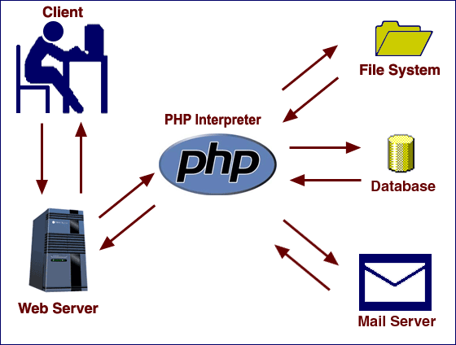
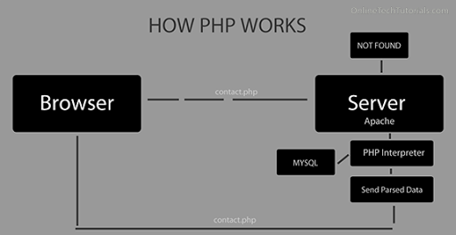
How PHP works
When a user navigates in his/her browser to a page that ends with a .php extension, the request is sent to a web server, which directs the request to the PHP interpreter.

Slide 13
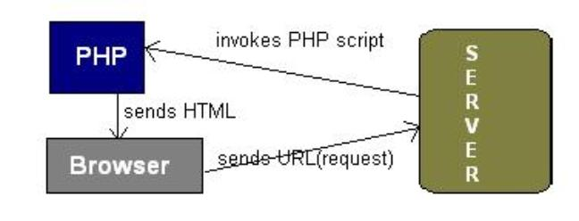
  URL is typed in the browser.
  The browser sends a request to the web server.
  The web server then calls the PHP script on that page.
  The PHP module executes the script, which then sends out the result in the form of HTML back to the browser, which can be seen on the screen.

Slide 14
What does PHP code look like?
Structurally similar to C/C++
Here some similarities and differences in PHP and C :
Similarities:
Broadly speaking, PHP syntax is the same as in C:
  statements are terminated with semicolons,
  function calls have the same structure (my_function(expression1, expression2)), and curly braces ({ and }) make statements into blocks.
  PHP supports C and C++-style comments (/* */ as well as //), and also Perl and shell-script style (#).

Slide 15
Similarities(cont’d)
Operators:
  The assignment operators (=, +=, *=, and so on),
  Boolean operators (&&, ||, !)
  the comparison operators (<,>, <=, >=, ==, !=), and the basic arithmetic operators (+, -, *, /, %) all behave in PHP as they do in C.
Control structures:
  The basic control structures (if, switch, while, for) behave as they do in C, including supporting break and continue.
  One notable difference is that switch in PHP can accept strings as case identifiers.

Slide 16
Similarities (cont’d)
Function names:
  As you peruse the documentation, you all see many function names that seem identical to C functions.
Differences:
Dollar signs:
  All variables are denoted with a leading $. Variables do not need to be declared in advance of assignment

Slide 17
Differences compare to C
Types:
  PHP has only two numerical types: integer (corresponding to a long in C) and double (corresponding to a double in C).
  Strings are of arbitrary length.
  There is no separate character type.
Arrays:
  Arrays have a syntax superficially similar to C's array syntax, but they are implemented completely differently.
  They are actually associative arrays or hashes, and the index can be either a number or a string.
  They do not need to be declared or allocated in advance.

Slide 18
Differences compare to C
No structure type:
  There is no struct in PHP
No pointers:
  There are no pointers available in PHP.
  PHP does support variable references. You can also emulate function pointers to some extent, in that function names can be stored in variables and called by using the variable rather than a literal name.
No prototypes:
  Functions do not need to be declared before their implementation is defined, as long as the function definition can be found somewhere in the current code file or included files.

Slide 19
PHP Language Basics
Structurally similar to C/C++
All PHP statements end with a semi-colon
Each PHP script must be enclosed in the reserved PHP tag
PHP Tag Styles as follows:
<?php
…
?>
short-open tag
<?...?>
Expression Tag
<?=...?>
HTML script tags
<script language="PHP">...</script>

Slide 20
Comments in PHP
There are two commenting formats in PHP:
1. Single-line comments
2. Multi-lines comments
// C++ and Java-style comment
# This is the second line of the comment
/* C-style comments
These can span multiple lines */

Slide 21
PHP Variables
PHP variables must begin with a “$” sign
Case-sensitive ($Foo != $foo != $fOo)
Certain variable names reserved by PHP
For Example Form variables ($_POST, $_GET) Etc.
<?php
$foo = 25; // Numerical variable
$bar = “Hello”; // String variable
$foo = ($foo * 7); // Multiplies foo by 7
?>

Slide 22
PHP Variable Naming Conventions
There are a few rules that you need to follow when choosing a name for your PHP variables.
PHP variables must start with a letter or underscore "_".
PHP variables may only be comprised of alpha-numeric characters and underscores. a-z, A-Z, 0-9, or _ .
Variables with more than one word should be separated with underscores. $my_variable
Variables with more than one word can also be distinguished with capitalization. $myVariable

Slide 23
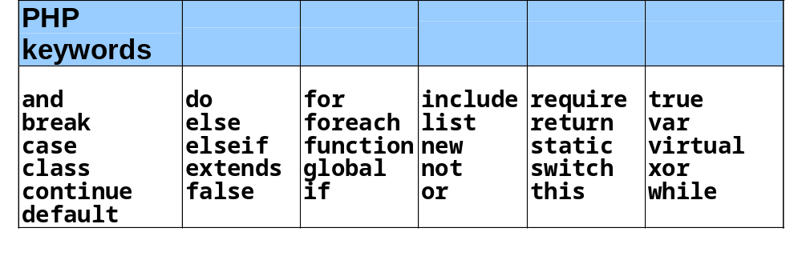
PHP keywords

Slide 24
echo
The PHP command ‘echo’ is used to output the parameters passed to it
Strings in single quotes (‘ ’) are not interpreted or evaluated by PHP
<?php
$foo = 25; // Numerical variable
$bar = “Hello”; // String variable
echo $bar; // Outputs Hello
echo $foo,$bar; // Outputs 25Hello
echo “5x5=”,$foo; // Outputs 5x5=25
echo “5x5=$foo”; // Outputs 5x5=25
echo ‘5x5=$foo’; // Outputs 5x5=$foo
?>
Notice how echo ‘5x5=$foo’ outputs $foo rather than replacing it with 25
Strings in single quotes (‘ ’) are not interpreted or evaluated by PHP

Slide 25
Concatenation
Use a period to join strings into one.
<?php
$string1=“Hello”;
$string2=“PHP”;
$string3=$string1 . “ ” . $string2;
echo $string3;
?>
Hello PHP
Escaping the Character
If the string has a set of double quotation marks that must remain visible, use the \ [backslash] before the quotation marks to ignore and display them.
<?php
$heading=“\”Computer Science\””;
Print $heading;
?>
“Computer Science”

Slide 26
Operators Examples
Assume variable A holds 10 and variable B holds 20 then:
Type | Operator | Description | Example
Arithmetic | + | Adds two operands | A + B will give 30
Comparision | == | Checks if the value of two operands are equal or not, if yes then condition becomes true. | (A == B) is not true.
Logical (or Relational) Operators | and | If both the operands are true then then condition becomes true. | (A and B) is true.
Assignment Operators | += | It adds right operand to the left operand and assign the result to left operand | C += A is equivalent to C = C + A
Conditional (or ternary) Operators | ? : | Conditional Expression | If Condition is true ? Then value X : Otherwise value Y

Slide 27
PHP Decision Making
The if, else …elseif and switch statements are used to take decision based on the different condition.
<?php
$my_name = "someguy";
if ( $my_name == "someguy" ) {
echo "Your name is someguy!<br />";
}
echo "Welcome to my homepage!";
?>
<?php
If($user==“John”)
{
Print “Hello John.”;
}
Else
{
Print “You are not John.”;
}
?>
No THEN in PHP

Slide 28
PHP Loop Types
Loops in PHP are used to execute the same block of code a specified number of times. PHP supports following four loop types.
While | while - loops through a block of code if and as long as a specified condition is true.
do...while | do...while - loops through a block of code once, and then repeats the loop as long as a special condition is true.
for – loop | for - loops through a block of code a specified number of times.
foreach | foreach - loops through a block of code for each element in an array.

Slide 29
PHP Arrays
An array stores one or more similar type of values in a single value.
An array is a special variable, which can store multiple values in one single variable.
In PHP, there are three kind of arrays:
Numeric array - An array with a numeric index
Associative array - An array where each ID key is associated with a value
Multidimensional array - An array containing one or more arrays

Slide 30
Looping through Arrays
Looping through element values
Looping through keys and values
Sorting an Array in PHP
You can sort an array in PHP by using two functions:
sort(), to sort an array in ascending order
rsort(), to sort an array in the reverse order, or descending order
foreach ( $array as $value ) {
// Do stuff with $value
}
foreach ( $array as $key => $value ) {
// Do stuff with $key and/or $value
}

Slide 31
Date Display
$datedisplay=date(“yyyy/m/d”);
echo $datedisplay;
2011/4/19
$datedisplay=date(“l, F m, Y”);
echo $datedisplay;
Tuesday, April 19, 2011
$date display=date(“D”);
echo $d
Tue

Slide 32
Functions
PHP functions are similar to other programming languages.
A function is a piece of code which takes one more input in the form of parameter and does some processing and returns a value.
There are two parts which should be clear to you:
Creating a PHP Function
Calling a PHP Function
function functionName()
{
code to be executed;
}

Slide 33
PHP File Inclusion
You can include the content of a PHP file into another PHP file before the server executes it.
There are two PHP functions which can be used to included one PHP file into another PHP file.
The include() Function
The require() Function
This is a strong point of PHP which helps in creating functions,
headers, footers, or elements that can be reused on multiple pages.
This will help developers to make it easy to change
the layout of complete website with minimal effort.
If there is any change required then instead of changing
thausand of files just change included file.

Slide 34


